Slide 1
The sharks mystery of sleep
106
15 17 18 19 20 22
(Mystery:謎)

Slide 2
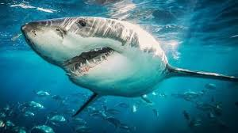
For we know very little about sharks, how they sleep is a mystery. But what we do know is that sharks must be allowed to breathe the water from flowing through the gills, so most sharks are side trips while sleeping.
Flowing:平滑的
Gill:鰓
Trip:此指行動中

Slide 3
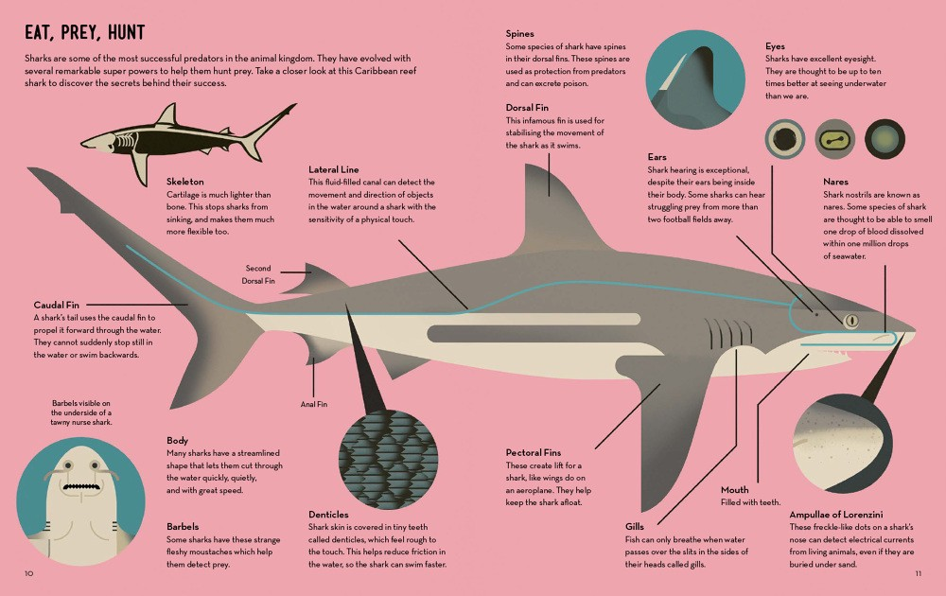
But some of the smaller size of sharks, such as the nurse shark (also known as nurse sharks), lying quietly in the seabed, they can use the breathing holes (each hole in the back of the eye) to help water flow through the gills.
Quietly:平靜的
Seabed:海床 海底

Slide 4
Recently, in the vicinity of, the researchers Baja California Peninsula in Mexico by the submersible robot, the first shot to the great white shark sleeping picture.
Recently:最近
Vicinity:鄰近
Researcher:研究員
submersible robot:潛入水下的機器人
Shot:(shoot過去式) 拍照

Slide 5
The footage shows, a female shark swim at nightfall to shallow waters close to shore, the mouth directly into the strong currents, so that water flowing from the gills, and then the shark swimming speed gradually slowing, the researchers believe, then sharks had fallen asleep.
footage:鏡頭current:潮流
Nightfall:傍晚 日暮 speed:迅速 急速
shallow: 變淺 gradually: 逐漸的
directly :截然

Slide 6
Chinese words
對於鯊魚我們所知甚少，它們如何睡覺更是一個謎。但我們所知道的是，鯊魚要呼吸必須讓水從鰓中流過，因此大多數鯊魚都是一邊游一邊睡的。但一些體型較小的鯊魚，如護士鯊（也叫鉸口鯊），在靜靜躺在海底時，它們可以用呼吸孔（每隻眼睛後面的小洞）幫助水從鰓中流過。
最近，在墨西哥的下加利福尼亞半島附近，研究人員通過潛入水下的機器人，首次拍攝到大白鯊睡覺的畫面。
鏡頭顯示，一頭雌性鯊魚在夜幕降臨時游到了接近岸邊的淺水區，用嘴直接對著強勁的水流，讓水從鰓中流過，然後鯊魚游水的速度漸漸放緩，研究者認為，這時鯊魚已經睡著了。

Slide 7
Experience
This English briefing is the first briefing in high school, and it is also the first time that I report in English. There may be many places that are not mature, but I believe that the content of this report has laid the foundation for the skilled skills needed in the future.

Slide 8

Thank you for watching

